Slide 1
Tutorial for UBEM District Description
Created by Royden Soh Wei Jun, 11 June 2025

Slide 2
Prerequisites
Basic Rhino3D understanding
Basic Grasshopper understanding
Anemone module downloaded for Grasshopper
Version: Anemone 0.4
https://www.food4rhino.com/en/app/anemone

Slide 3
Overall Workflow
Create (or get existing) district massing
Assign an archetype to each building
Use custom Grasshopper script to calculate GFA of each building
Copy data to excel sheet (District Individual Building GFAs.xlsx)
Run EC_district Python scripts

Slide 4
1) Create/Get district massing

Slide 5
If you already have the massing of the district you want to study, great! Go to step 2.
Some cases for this include:
An existing (already constructed) district
Confirmed plans for an upcoming district
Otherwise…
1) Create/Get district massing

Slide 6
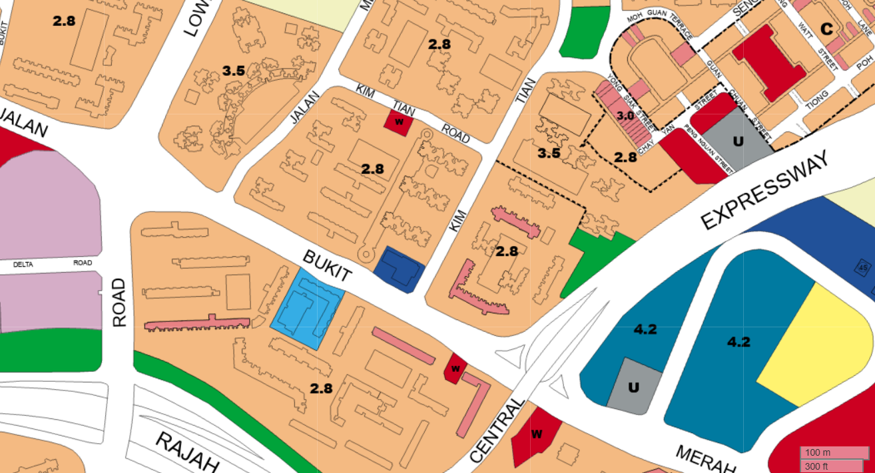
If you need to create a plausible district massing, here are some guidelines for the Singapore context:
Get the latest Master Plan from https://eservice.ura.gov.sg/maps/?service=MP. Screenshot, import into Rhino, and ensure the image is scaled appropriately to reflect real world dimensions.
Ensure proper scaling in Rhino by including the Master Plan scale in the screenshot
1) Create/Get district massing

Slide 7
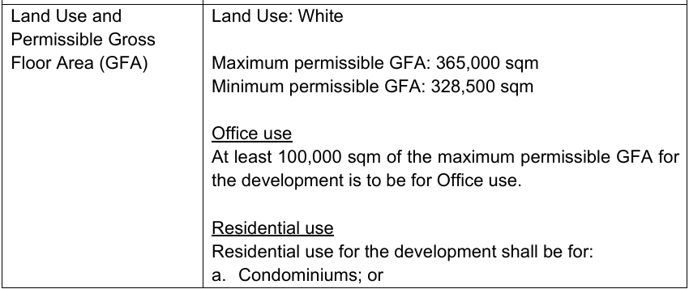
If analysing an upcoming district, check the URA website to see if any GFA guidelines or regulations are released. These are constraints that must be followed.
District-wide GFA restrictions
Office GFA restrictions
(example: Technical Conditions of Tender for Jurong Lake District)
1) Create/Get district massing

Slide 8
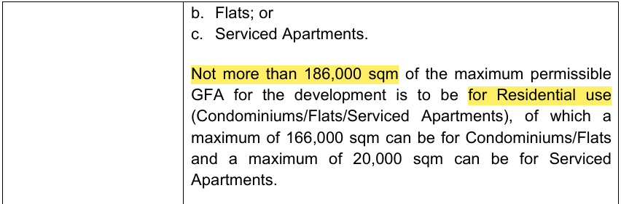
If analysing an upcoming district, check the URA website to see if any GFA guidelines or regulations are released. These are constraints that must be followed.
Residential GFA restrictions
(example: Technical Conditions of Tender for Jurong Lake District)
1) Create/Get district massing

Slide 9
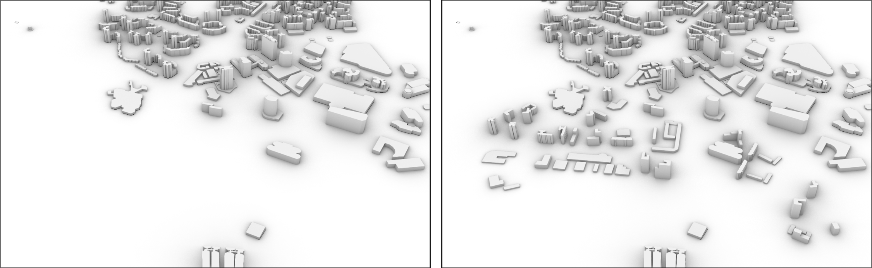
Create a more realistic massing by using https://cadmapper.com/ and copying existing building massing to the study area
Copy existing massing to study area
1) Create/Get district massing

Slide 10
2) Assign an archetype to each building

Slide 11
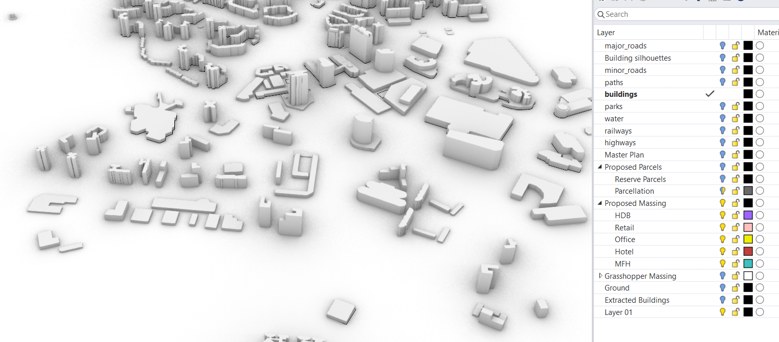
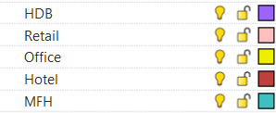
In Rhino, create a layer or sub-layer for each building archetype
(example: Jurong Lake District where we suppose that these 5 archetypes will make up the entire district)
2) Assign an archetype to each building

Slide 12

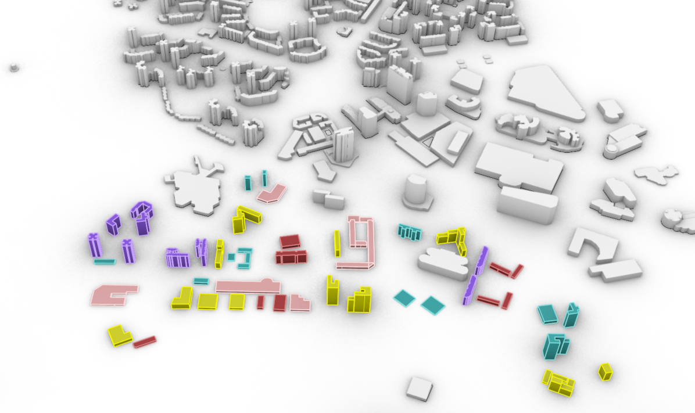
For each building, assign it to the correct layer
Use the “ChangeLayer” command in Rhino
2) Assign an archetype to each building

Slide 13
3) Use custom Grasshopper script to calculate GFA of each building

Slide 14
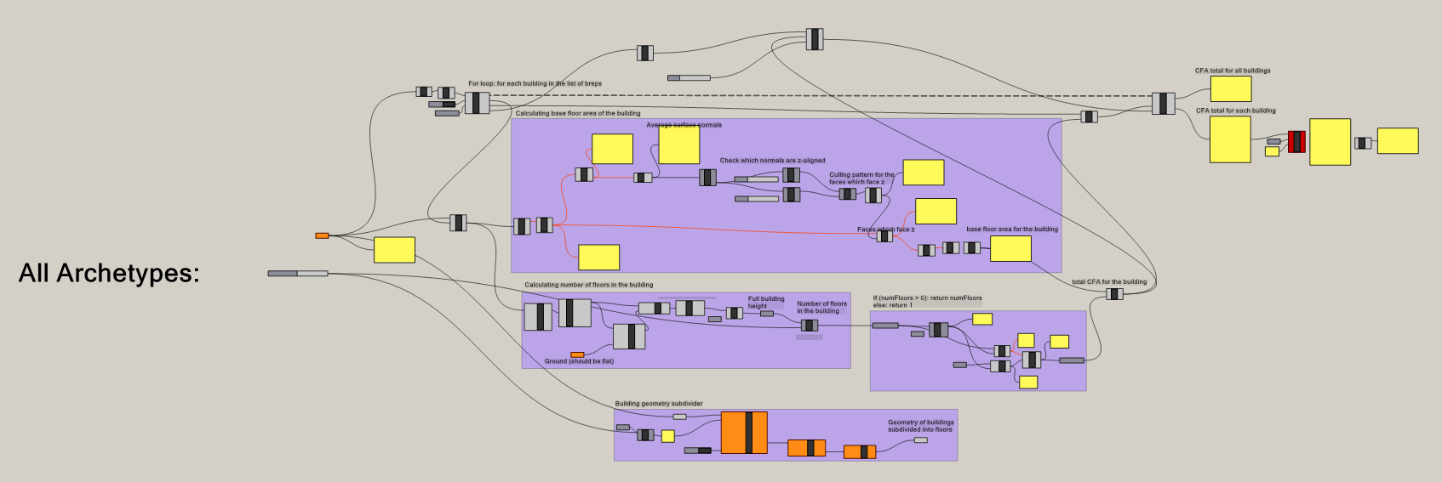
Open the Grasshopper file: Building GFA Calculator.gh
This “All Archetypes” part represents a copy-able module
3) Use custom Grasshopper script to calculate GFA of each building

Slide 15
3 main inputs to the module are required:
The ground plane
The Breps for the appropriate building massing
The floor to floor height
2) Archetype Breps
3) Floor to floor height
1) Ground plane
3) Use custom Grasshopper script to calculate GFA of each building

Slide 16
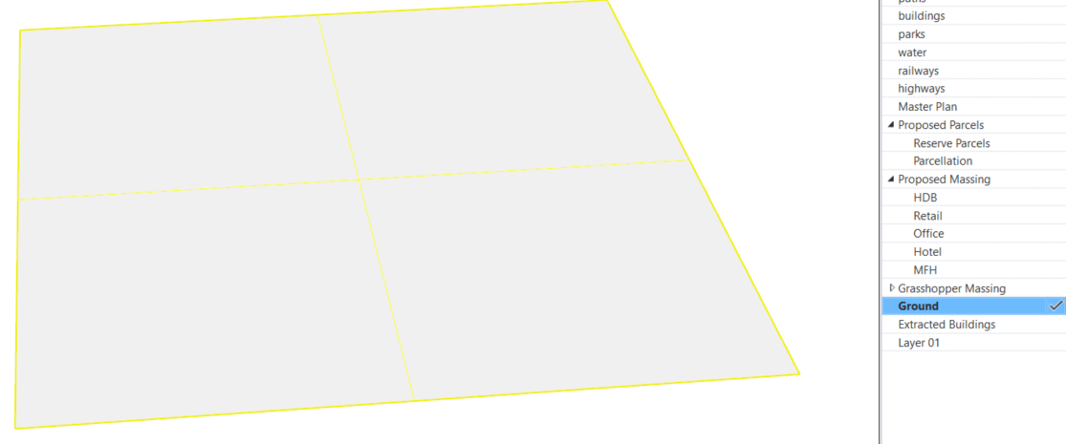
Input 1: ground plane
Simply create a plane at z = 0 using the Rhino “Plane” command
Thus, this script assumes that the district is sitting on flat ground (unable to deal with uneven terrain)
3) Use custom Grasshopper script to calculate GFA of each building

Slide 17
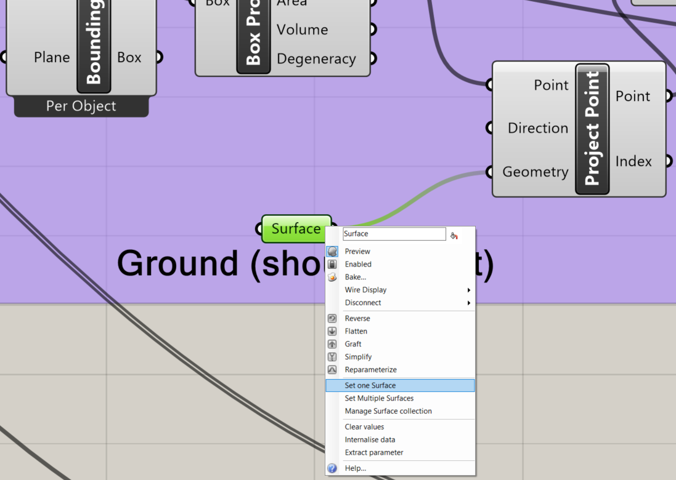
Input 1: ground plane
In Grasshopper, right click on the Surface component > Set one Surface
Then click on the created plane in Rhino to select it
3) Use custom Grasshopper script to calculate GFA of each building

Slide 18
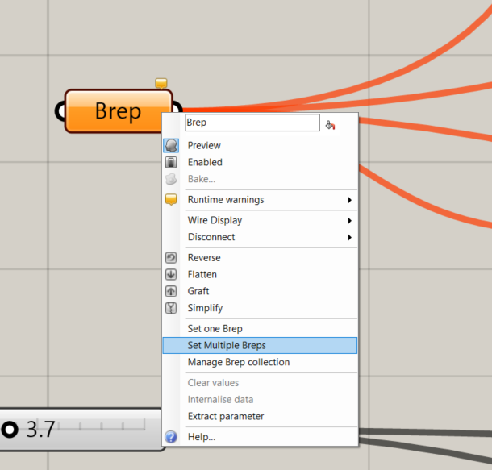
Input 2: archetype Breps
In Grasshopper, right click on the Brep component > Set Multiple Breps
3) Use custom Grasshopper script to calculate GFA of each building

Slide 19
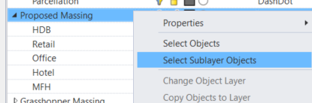
Input 2: archetype Breps
In Rhino, select all the buildings that belong to the archetype being studied
In this case, the module is for “All Archetypes” so in this case with the Rhino layers structured in this manner, we
Right-click on Proposed Massing
Click on Select Sublayer Objects
Press Enter
3) Use custom Grasshopper script to calculate GFA of each building

Slide 20
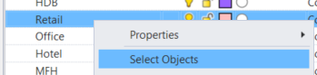
Input 2: archetype Breps
If for example, you only want to get the GFAs of buildings belonging to the Retail archetype,
Right click on the Retail layer
Click on Select Objects
Press Enter
3) Use custom Grasshopper script to calculate GFA of each building

Slide 21
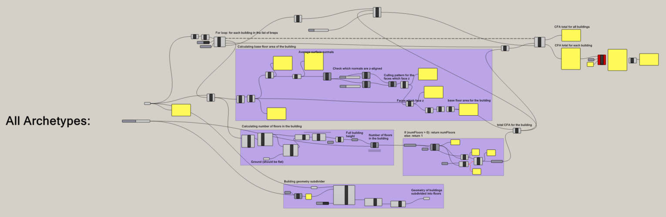
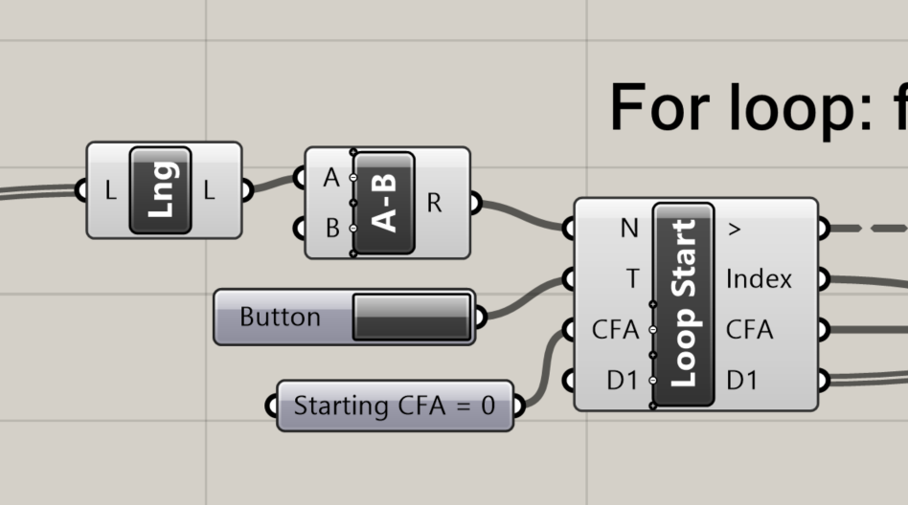
Now numbers might appear, but we need to make sure that the calculation loop executes properly
Click the button to start the execution of the GFA calculation loop
Loop button
3) Use custom Grasshopper script to calculate GFA of each building

Slide 22
Now we look at the right side of the Grasshopper module where the GFA results have been calculated
Results area
3) Use custom Grasshopper script to calculate GFA of each building

Slide 23
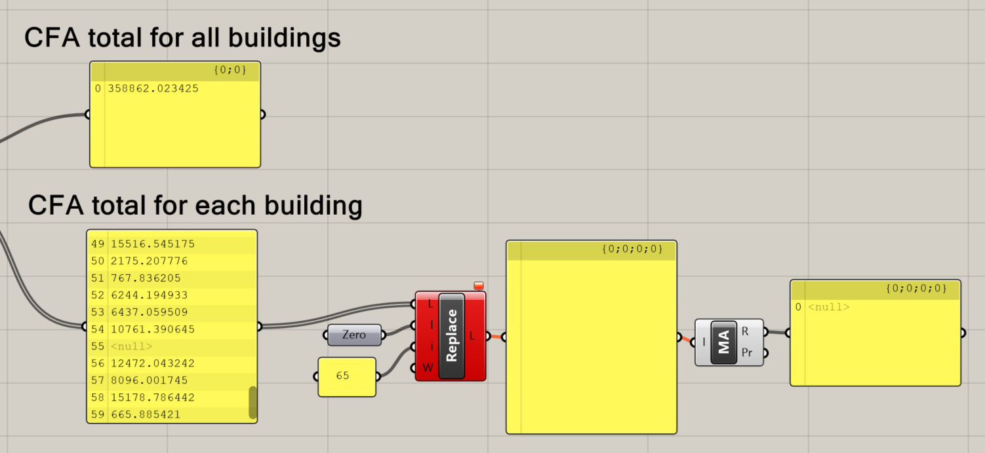
Due to some funny way that Grasshopper operates, a null value will be introduced into the list under “CFA total for each building”
In this case, it appears at #55 (will be different for each case)
Null value (in this case, at #55)
3) Use custom Grasshopper script to calculate GFA of each building

Slide 24
We need to manually resolve this by stating the correct serial number to replace with a zero
In this case, we use 55.
Change the serial number (in this case, to 55)
3) Use custom Grasshopper script to calculate GFA of each building

Slide 25
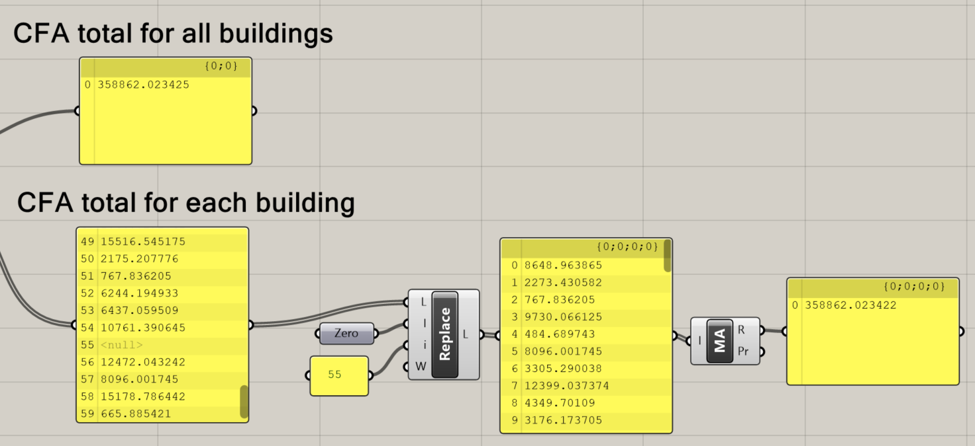
A list of only numbers will then be generated, representing the CFA of every building, individually
List of individual building CFAs
3) Use custom Grasshopper script to calculate GFA of each building

Slide 26
Sanity check, the CFA total across all the selected buildings should match
CFA total should match
3) Use custom Grasshopper script to calculate GFA of each building

Slide 27
So in summary, we now have, for all the selected buildings in this module:
The total CFA across all the buildings
The list of individual building CFAs
2) List of individual building CFAs
1) Total CFA across all buildings
3) Use custom Grasshopper script to calculate GFA of each building

Slide 28
3.5) Using the Grasshopper script on each archetype

Slide 29
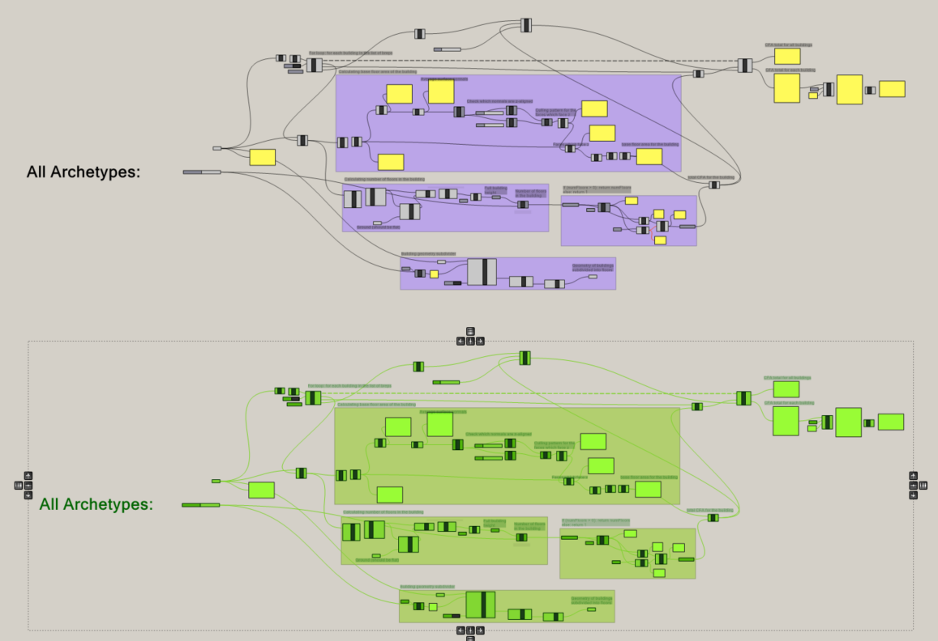
The example shown in Step 3 was for “All Archetypes”
To do it for each archetype separately, simply copy and paste the module
Copy and paste the module somewhere else in the Grasshopper script
3.5) Using the Grasshopper script on each archetype

Slide 30
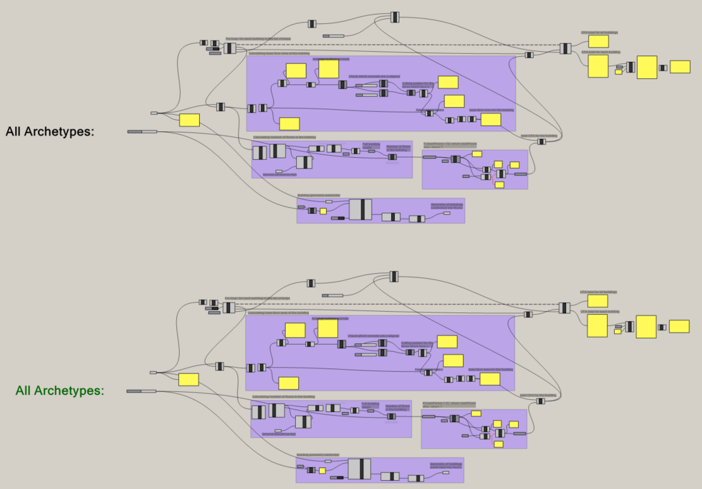
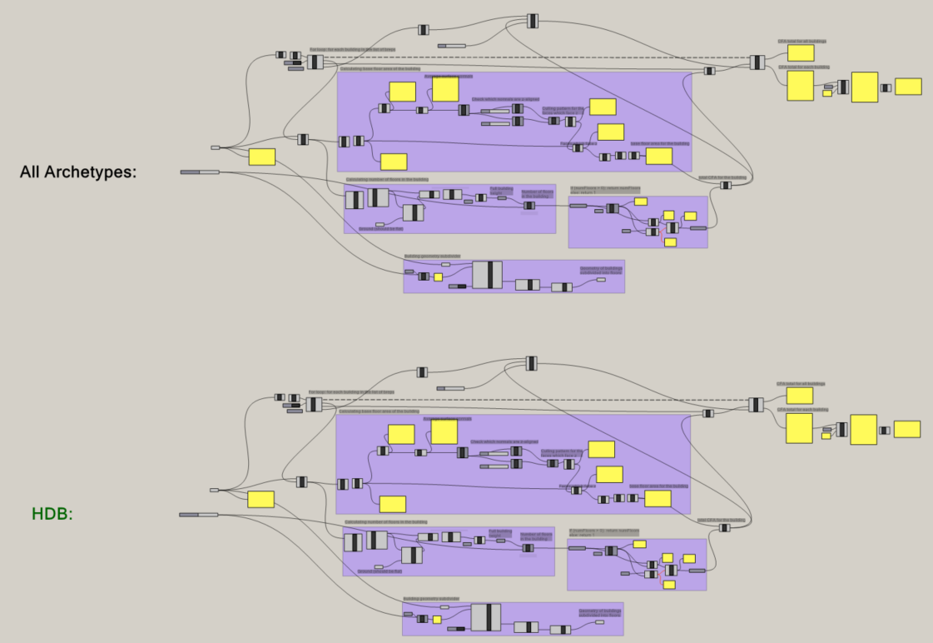
Change the module label so you don’t get confused
3.5) Using the Grasshopper script on each archetype

Slide 31
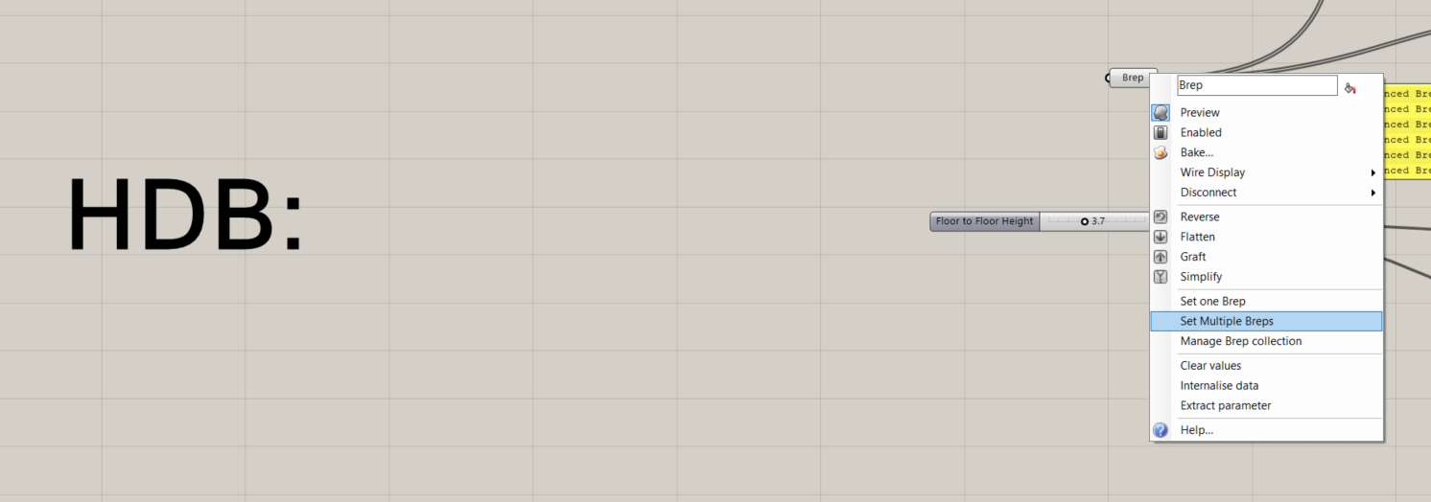
The ground plane is assumed to be the same, and hence no change is needed
You only need to change:
select only the appropriate Breps (in this case, HDB Breps)
The floor to floor height
3.5) Using the Grasshopper script on each archetype

Slide 32
4) Copy data to excel sheet

Slide 33
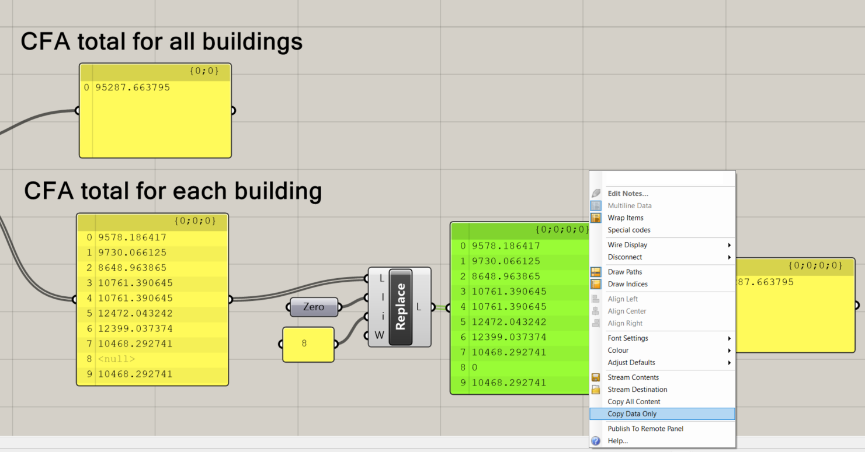
Copy the individual building CFAs by right clicking on the list > Copy Data Only
4) Copy data to excel sheet

Slide 34
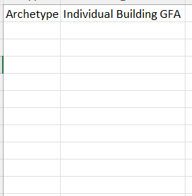
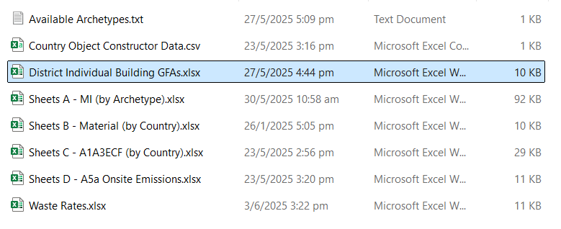
Open data/District Individual Building GFAs.xlsx
4) Copy data to excel sheet

Slide 35
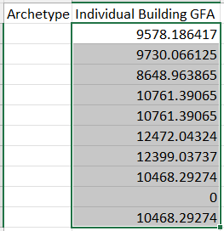
Paste the data under the “Individual Building GFA” column
4) Copy data to excel sheet

Slide 36
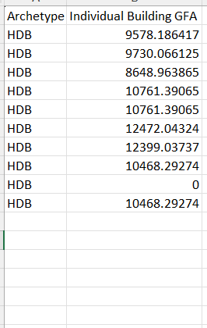
In this case, the GFAs were copied from a module in the Grasshopper script dealing with only HDB buildings
Hence, we fill in “HDB” under the “Archetype” column
4) Copy data to excel sheet

Slide 37
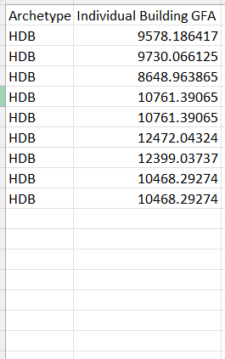
Feel free to delete the entry where the GFA = 0
For the case of embodied carbon only, this is not necessary but it is still good practice to do so
Delete GFA = 0 entry!
4) Copy data to excel sheet

Slide 38
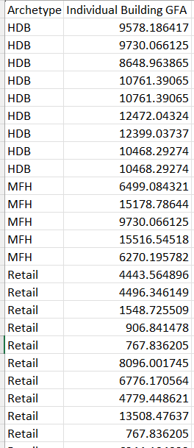
Copy in the rest of the archetypes until you have a complete description of the district being studied
Remember to delete GFA = 0 entries
4) Copy data to excel sheet

Slide 39
5) Run EC_district Python scripts

Slide 40
This consists of 2 scripts in the src folder:
EC_district_execution.py
EC_district_results.py
Follow the Python_Documentation.md file for more detailed instructions on how to use these scripts.
5) Run EC_district Python scripts

